Slide 1
Bapatla engineering college::bapatla (autonomous) department of information technology
Internal project review – 1
On
AI BASED PRODUCT DEMAND AND SALES TREND ANALYSIS
Under the estimated guidance
Of
Dr. B.Krishnaiah

Slide 2
BATCH MEMBERS
M.SHANKAR-Y22AIT475
N.SIVA KUMARI-Y22AIT484
Y.JITENDRA-Y22AIT527
P.LALITHA-Y22AIT490

Slide 3
Title
AI BASED PRODUCT DEMAND AND SALES TREND ANALYSIS

Slide 4
Table of contents
Abstract
System architecture
Methodology
Partial implementation

Slide 5
ABSTRACT
This project focuses on predicting supermarket item sales for the next two months using historical sales data. Supermarkets generate large amounts of sales data every day, including product names, categories, quantities sold, and total sales amounts. Analyzing this data helps in understanding customer purchasing behavior and future demand.
The main objective of this project is to analyze the previous two months of supermarket sales data and predict the items that are likely to be sold in the coming months. The dataset includes various categories such as grocery, dairy products, fruits, vegetables, snacks, and household items. By studying past sales patterns, the system estimates future sales trends.
Sales prediction helps supermarkets maintain proper inventory levels, reduce stock shortages, and improve customer satisfaction. Essential products such as rice, milk, cooking oil, and sugar are expected to have consistent demand, while snacks and beverages may show moderate variation in sales.
This project uses sales data analysis methods to forecast future sales and assist supermarket management in planning inventory efficiently. The prediction results help in better decision-making and improved supermarket operations.

Slide 6
DOMAIN KNOWLEDGE
1. Introduction
Supermarket sales prediction is the process of estimating the number of items that will be sold in the future based on historical sales data. Supermarkets such as DMart and other retail stores use sales prediction to maintain proper inventory and avoid shortages or overstocking.
Sales prediction helps store managers understand customer demand and plan stock levels efficiently. By analyzing previous sales data, we can predict the items that will be sold in the next two months.

Slide 7
2. Supermarket Sales System
A supermarket sales system records daily transactions including:
Product Name
Category
Quantity Sold
Price
Date of Sale
Total Amount
Payment Method
These details help in analyzing customer buying patterns.
Your system stores sales data and allows prediction using historical data. The system records product sales and calculates totals automatically.
3. Importance of Sales Prediction
Sales prediction is important because:
📦 Helps maintain proper stock levels
💰 Improves profit planning
📊 Helps understand customer demand
🏬 Reduces product shortages
🛒 Improves supermarket management
Supermarkets use prediction to ensure that essential items like rice, milk, and oil are always available.

Slide 8
4. Sales Prediction Method
The prediction of next 2 months sales is based on:
Previous 2 months sales data
Average daily sales
Monthly trends
Frequently sold products
The prediction system calculates daily and monthly sales patterns and estimates future sales.
5. Benefits of Prediction System
Benefits include:
Better inventory management
Reduced waste
Increased profit
Better customer satisfaction
Easy decision making

Slide 9
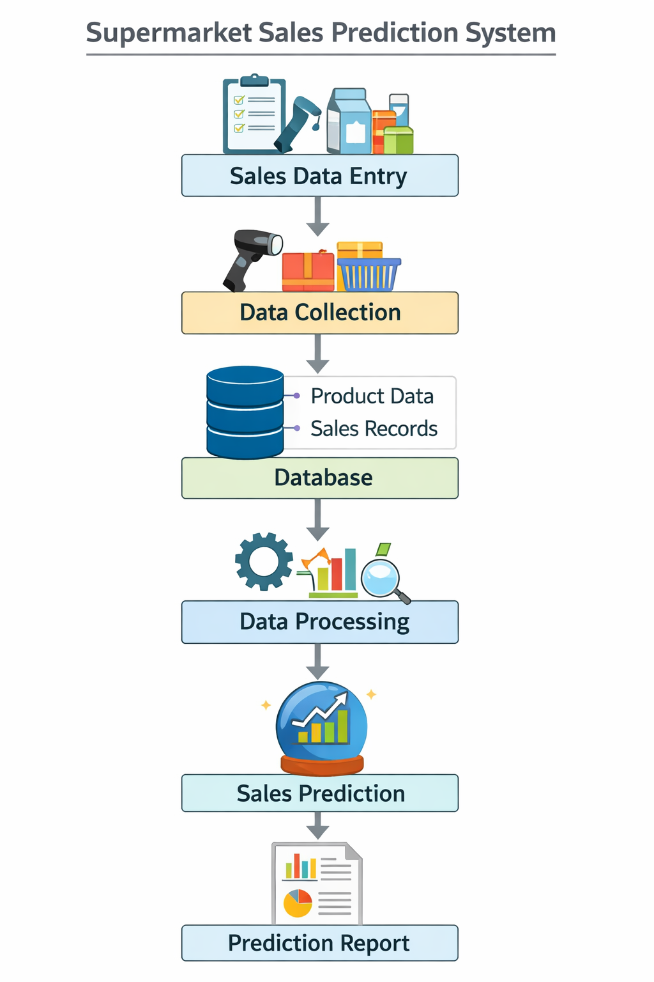
SYSTEM ARCHITECTURE

Slide 10
Methodology
Sales data was collected from the supermarket billing records for the previous two months.
The dataset includes product name, category, quantity sold, price, and date.
The collected data was stored in an Excel sheet for analysis.
The data was cleaned by removing errors and organizing by date.
Sales data was analyzed to identify frequently sold products.
Daily and monthly sales totals were calculated.
Average quantity sold for each product was determined.
Future sales were predicted based on past sales trends.
The next two months item sales were estimated using average sales values.
The prediction results help in planning supermarket inventory and stock management.
Sales data was collected from the supermarket billing records for the previous two months.
The dataset includes product name, category, quantity sold, price, and date.
The collected data was stored in an Excel sheet for analysis.
The data was cleaned by removing errors and organizing by date.
Sales data was analyzed to identify frequently sold products.
Daily and monthly sales totals were calculated.
Average quantity sold for each product was determined.

Slide 11
Development
Front End Tools Used:
HTML
CSS
JavaScript
Web Pages or Excel Interface
Back End Tools Used:
Python
Database
Data Processing Methods

Slide 12
ALGORITHMS
1. Average Sales Algorithm (Main Algorithm)
The main algorithm used in this project is the Average Sales Method.
This method predicts future sales based on past sales data.
Formula:
Average Sales = Total Quantity Sold ÷ Number of Days
Predicted Sales = Average Sales × Future Days
Example:
Rice sold = 300 units in 60 days
Average Sales = 300 ÷ 60 = 5 units per day
Prediction for next 60 days = 5 × 60 = 300 units
This method is simple and suitable for supermarket sales prediction

Slide 13
2. Trend Analysis Algorithm
Trend analysis is used to study past sales patterns.
It helps to identify:
High selling products
Low selling products
Monthly sales growth
Customer demand patterns
The system analyzes previous sales data to understand trends.
3. Summation Algorithm
This algorithm calculates total sales.
Formula:
Total Sales = Sum of All Sales Amounts
It is used to calculate:
Daily sales
Monthly sales
Product-wise sales

Slide 14
4. Prediction Algorithm
The prediction algorithm uses historical sales data to estimate future sales.
Steps:
Collect past sales data
Calculate total quantity sold
Calculate average sales
Predict next two months sales
5.Simple Statistical Algorithm
Basic statistical calculations are used:
Average
Total
Maximum sales
Minimum sales
These calculations help in understanding sales behavior.

Slide 15
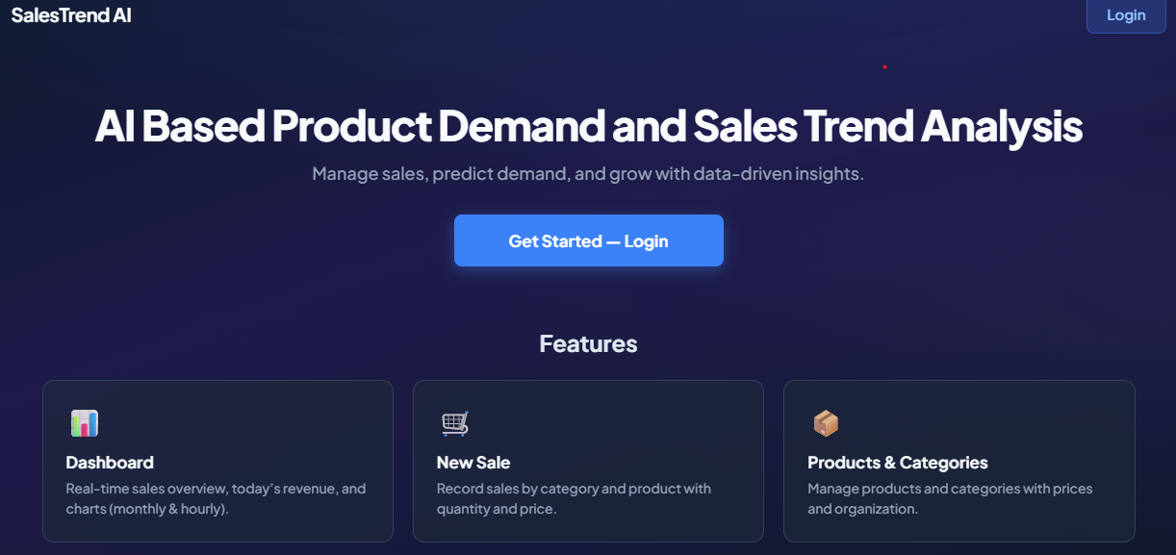
Partial Implementation

Slide 16
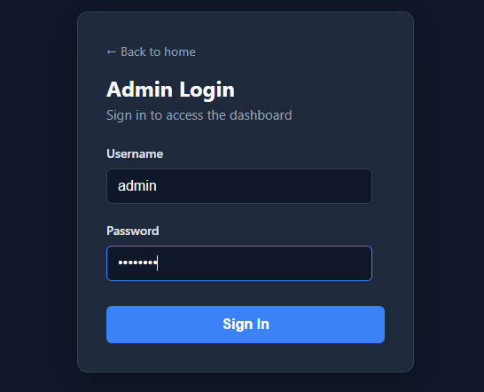

Slide 17
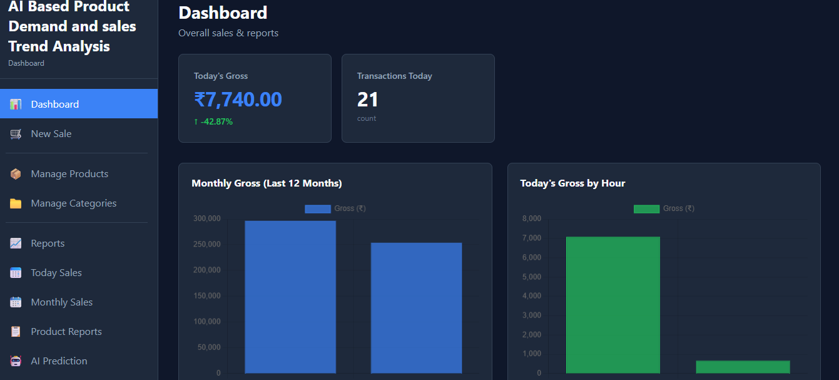

Slide 18
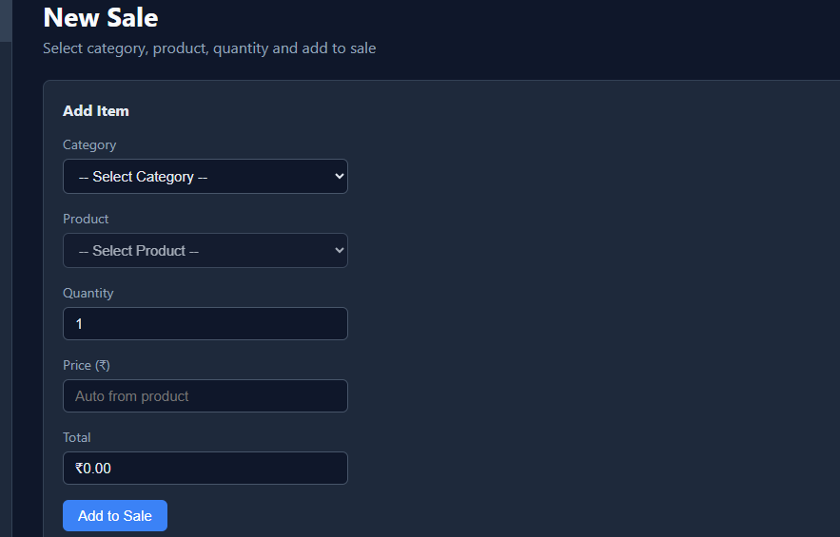

Slide 19
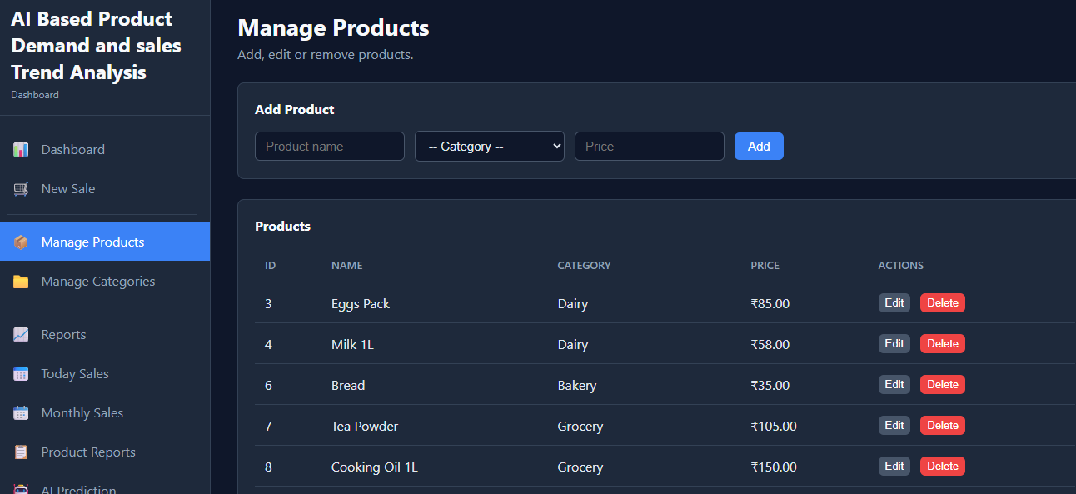

Slide 20
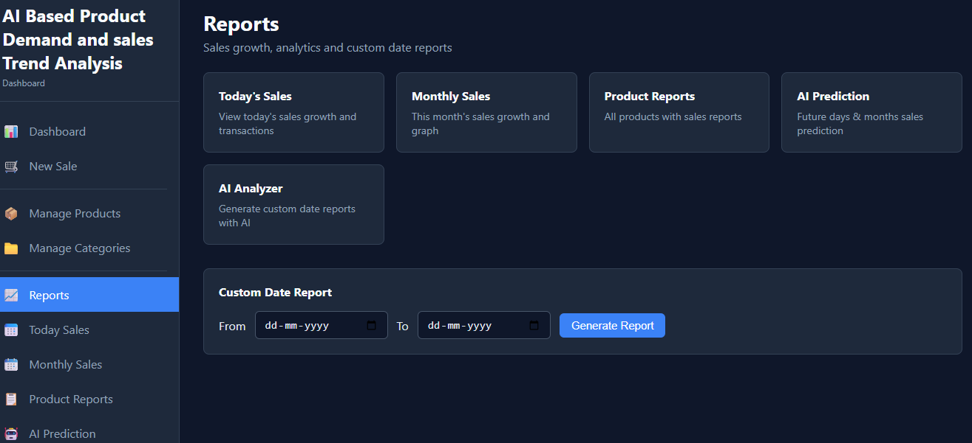

Slide 21
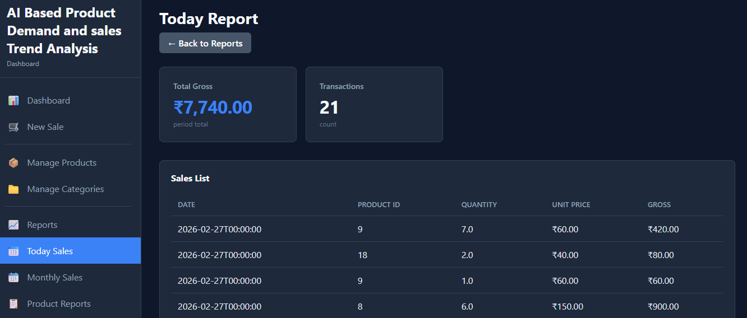

Slide 22
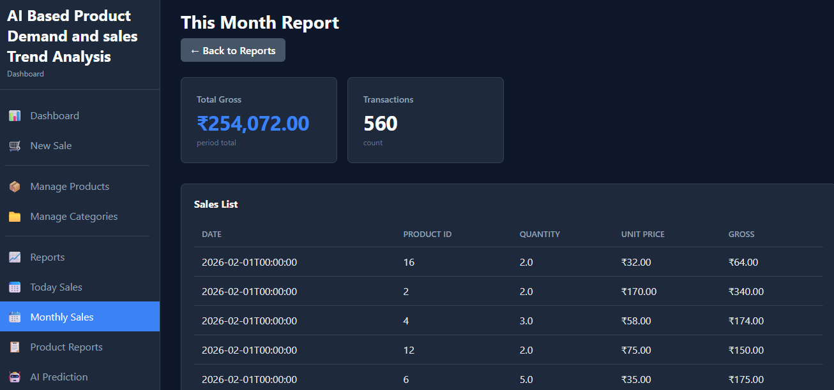

Slide 23
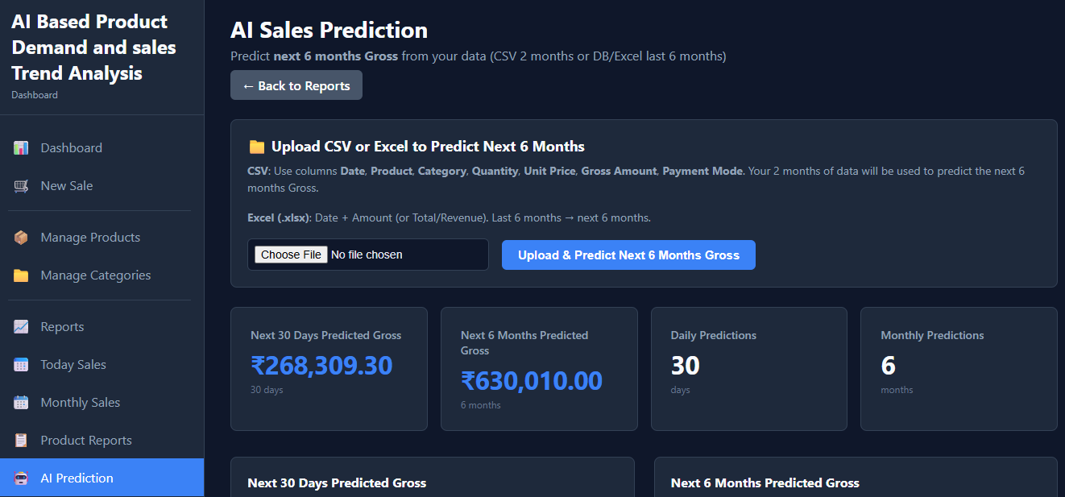

Slide 24
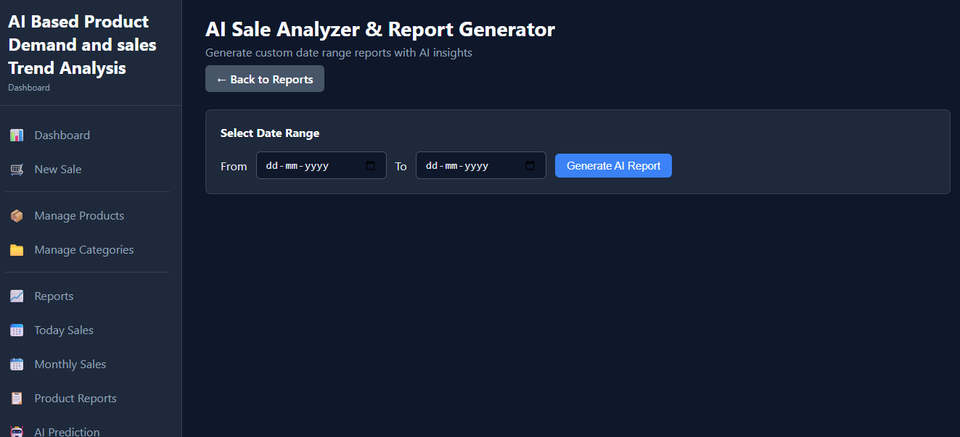

Slide 25


